Slide 1

GUVI Multilingual GPT Chatbot
Integrated Translation and Domain-Specific Model Deployment

Slide 2
Project Overview
This project focuses on building a multilingual chatbot using a pre-trained or fine-tuned GPT model. It integrates translation capabilities for non-English queries and responses, ensuring a seamless user experience.
1
2
Core Function
Key Models
Answer user queries using a GPT model, with translation for non-English inputs/outputs.
GPT model for responses, NLLB-200 model for multilingual translation.
3
4
Supported Languages
Deployment
Tamil, English, Telugu, Kannada, Malayalam.
Hugging Face Spaces/AWS with an interactive Streamlit UI.

Slide 3
Skills Acquired
Deep Learning & NLP
Streamlit Frontend Design
Hugging Face Models & LLM
API Integration & Deployment
Data Preprocessing & Cleaning
Real-time Chatbot Development
Transformer Model Fine-tuning
Version Control (Git)
This project covers key domains: Artificial Intelligence, Natural Language Processing, and Web Development.

Slide 4
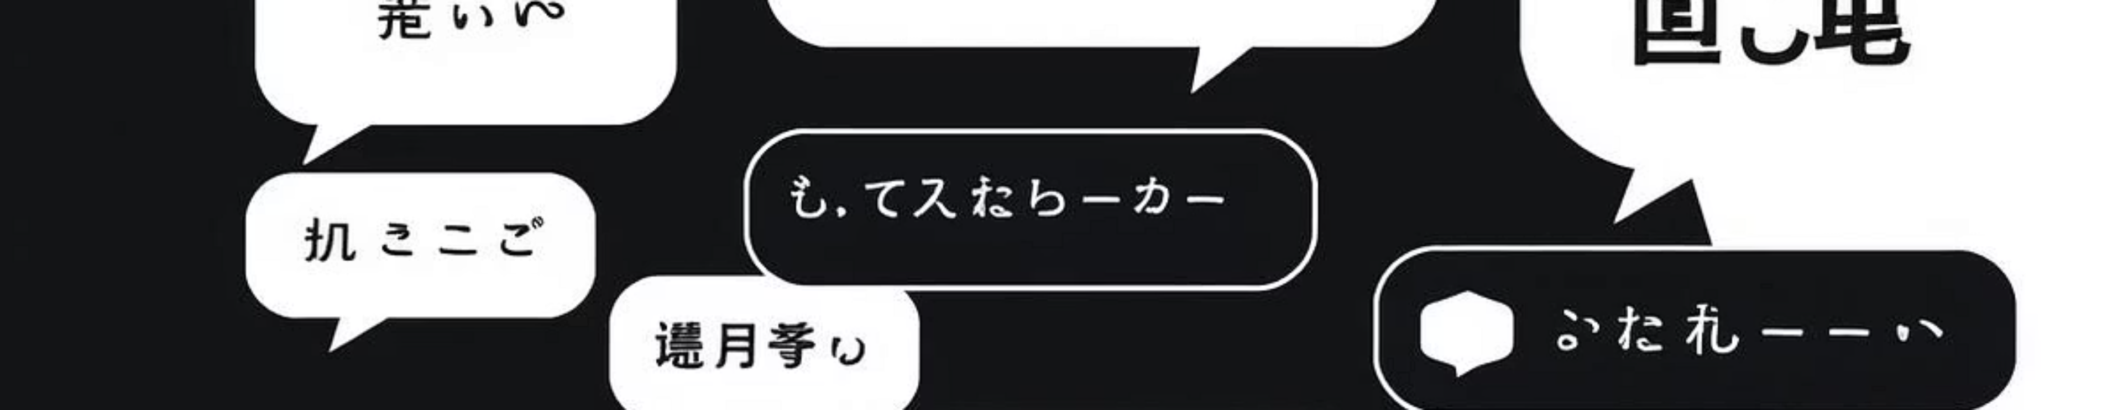
Problem Statement
Build a multilingual chatbot that uses a pre-trained or fine-tuned GPT model to answer user queries. If the user's input is in a non-English language, the chatbot should translate the input to English using a translator model (NLLB-200), get a response from the GPT model, and then translate the response back to the original language.
The chatbot will be deployed on Hugging Face Spaces/AWS with a clean, interactive UI for real-time conversations, assisting learners and enhancing their experience on the GUVI platform.

Slide 5




Business Use Cases
Customer Support Automation
E-Learning Platforms
Provide 24/7 multilingual support by translating queries and responses, eliminating the need for additional language experts.
Enhance accessibility and user satisfaction by interacting with students in their native languages for course inquiries and technical support.
Career Guidance
Course Discovery
Offer career suggestions, learning paths, and resources based on user interests and skills, simulating basic counseling.
Recommend specific GUVI courses, certifications, or masterclasses by asking users about their interests and goals.

Slide 6
Development Approach
01
02
Model Selection
Translation Logic
Choose suitable models from Hugging Face (including NLLB-200 for translation) with dynamic language routing.
Implement efficient, dynamic loading/calling of translation models based on source and target languages.
03
04
Streamlit UI/UX
Error Handling
Design a responsive interface with input, language selectors, and optional features like copy/clear buttons.
Gracefully manage loading failures, unsupported translations, and long inputs with user feedback.
05
06
Model Deployment
Version Control
Deploy the Streamlit app on Streamlit Cloud, Hugging Face Spaces, or other platforms, ensuring fast startup.
Maintain code on GitHub with proper versioning, commit messages, and a comprehensive README.

Slide 7
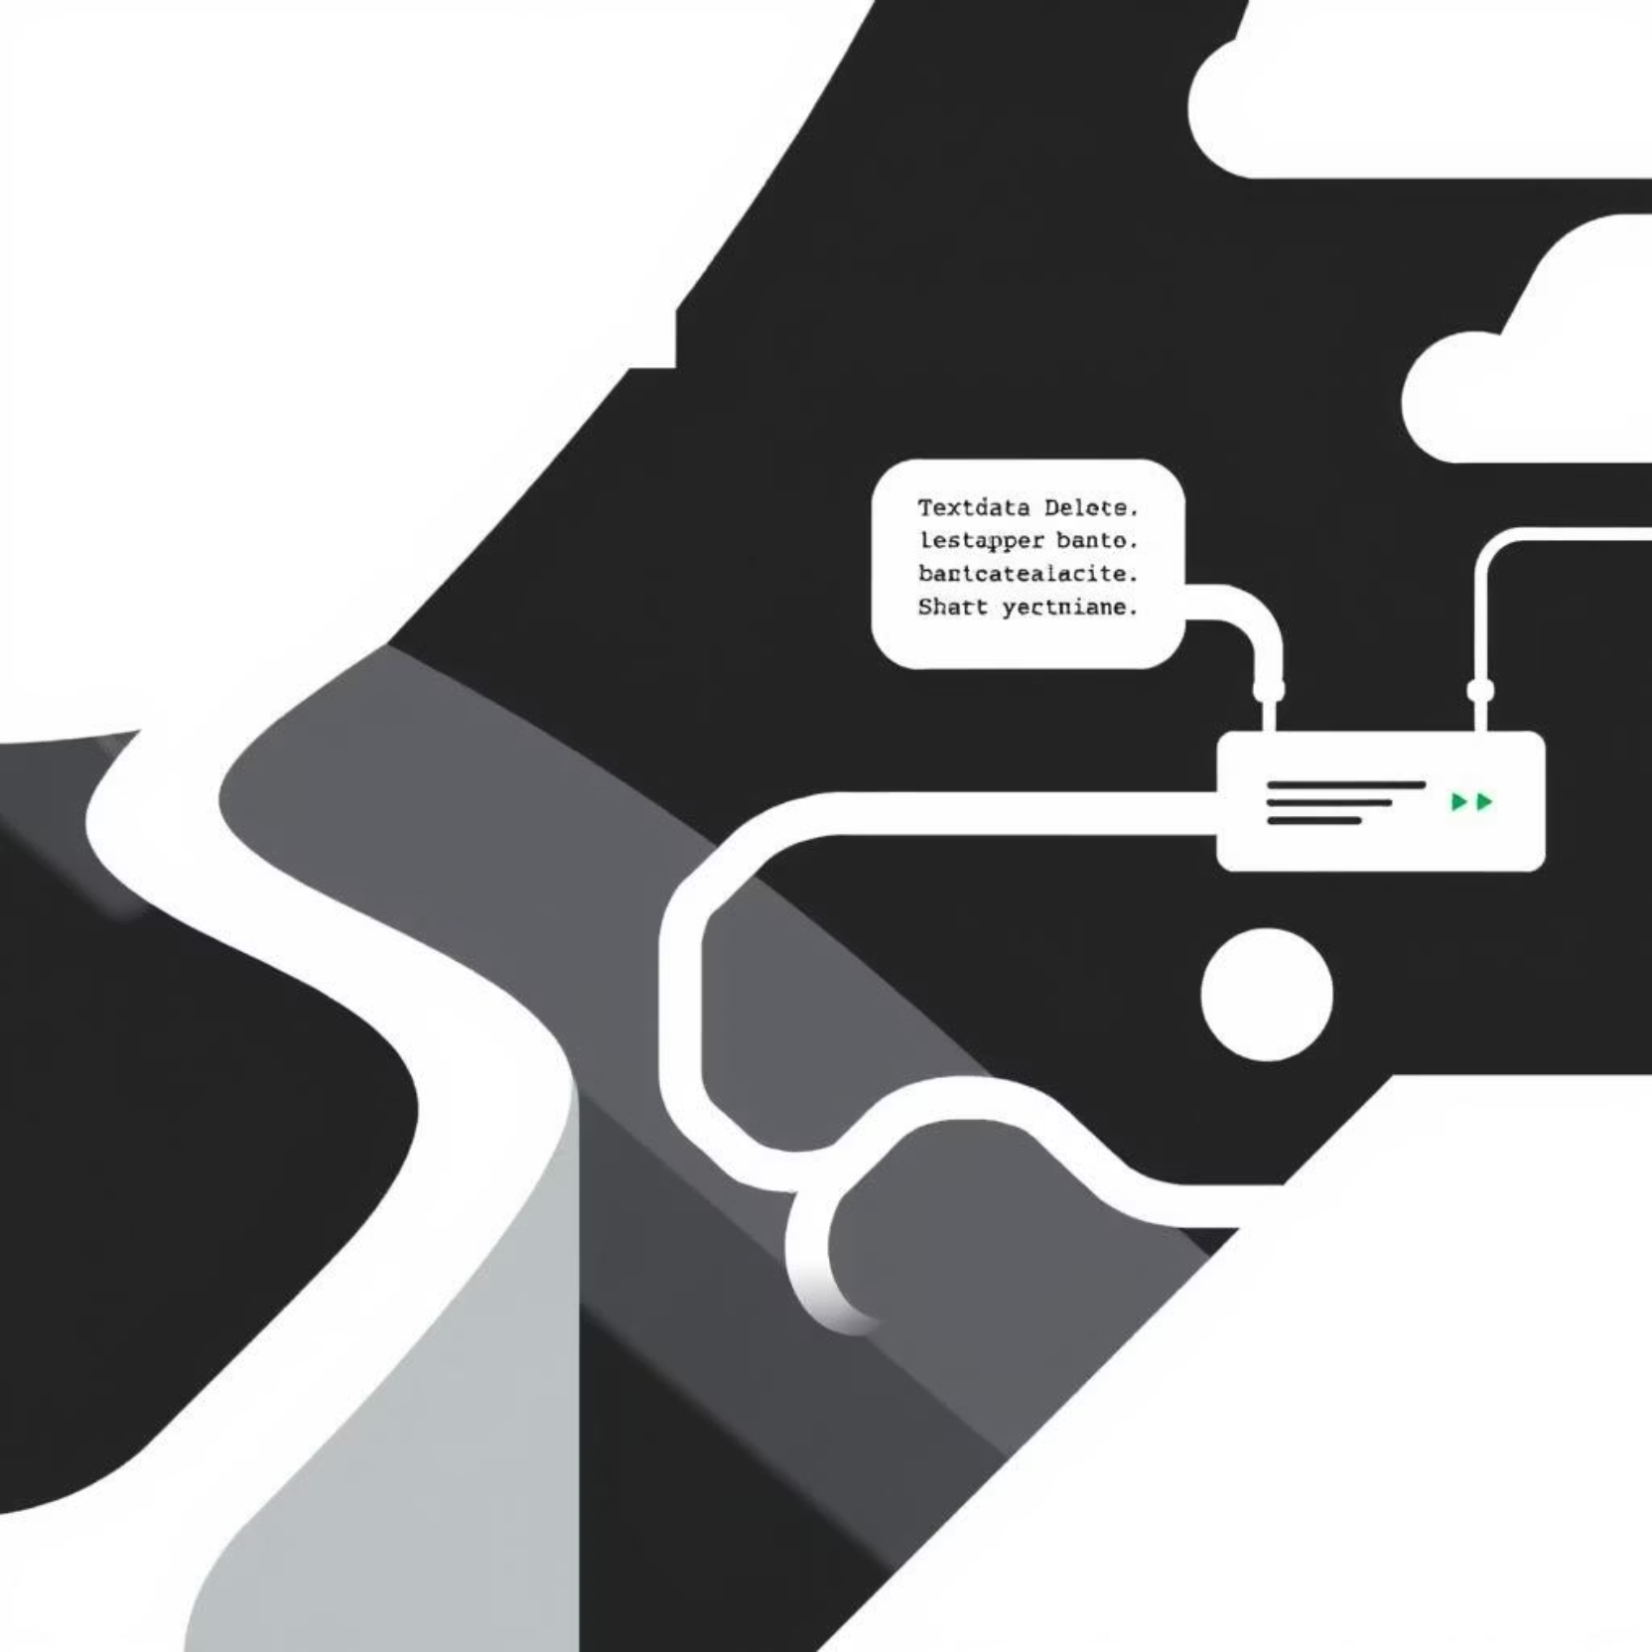
Fine-Tuning the Model
Fine-tuning involves several critical steps to optimize the model's performance for specific tasks:
Data Collection/Extraction: Gather text data from Hugging Face Datasets or GUVI resources.
Data Preparation: Clean and preprocess data for training (e.g., removing special characters).
Tokenization: Use model-specific tokenizers to split text into understandable tokens.
Fine-Tuning: Utilize Hugging Face Transformers to fine-tune the model on the prepared dataset.

Slide 8
Project Deliverables & Evaluation
Deliverables
Evaluation Metrics
Functional Web Application: Streamlit UI for multilingual input, translation, and GUVI GPT responses.
Modularity: Code in functional blocks.
Maintainability: Codebase can be easily maintained.
Portability: Works consistently across operating systems.
Scalable Deployment: Framework using Hugging Face/AWS services.
GitHub: Public repository with proper README, workflow, and execution details.
Documentation: Comprehensive setup, deployment, and usage instructions.
Coding Standards: Adherence to PEP8 and other best practices.
Data Files: app.py, requirements.txt, or access information.
Demo Video: Working model demo posted on LinkedIn.
Source Code: Well-organized, commented scripts and code files.

Slide 9
Data Set Guidelines
Relevant text data for fine-tuning the language translator model (NLLB-200) and GPT model will be gathered from Hugging Face Datasets and various GUVI sources (website, queries, social media, blogs, training materials).
10K-50K
100K-500K
1M+
Small Scale
Medium Scale
Large Scale
Sufficient for simple tasks or minor model adjustments, suitable for highly specialized content.
Provides substantial adjustments, often sufficient for many practical applications with moderately complex content.
Yields significant improvements for complex or diverse content, necessary for highly accurate and contextually rich text generation.

